Slide 1

Banking System Presentation Material

Slide 2
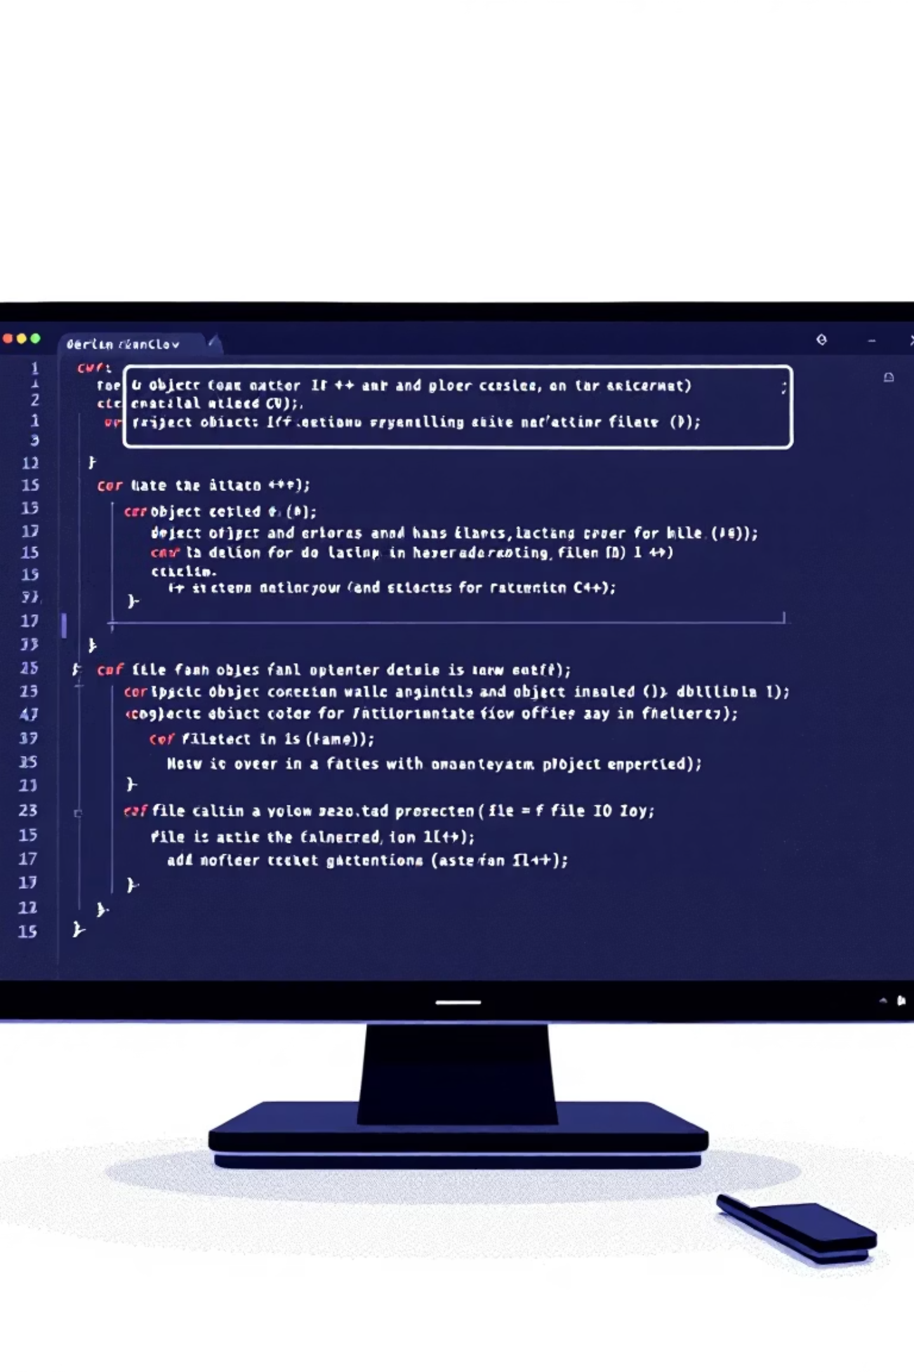
Banking Simulation System
A Secure Console-Based Banking Application
Developer:
Date:
Nitish Sahni
December 2024
Institution:
Technology Stack:
Acadia University (ID: 0263900s)
C++17 | Object-Oriented Programming | File I/O

Slide 3
Project Objectives
1
2
3
Secure Design
Core Operations
OOP Principles
Implement a secure banking simulation using modern C++.
Develop deposits, withdrawals, and transfers.
Apply object-oriented programming and design patterns.
4
5
User Interface
Data Persistence
Create an intuitive, console-based user interface.
Implement robust data persistence mechanisms.

Slide 4
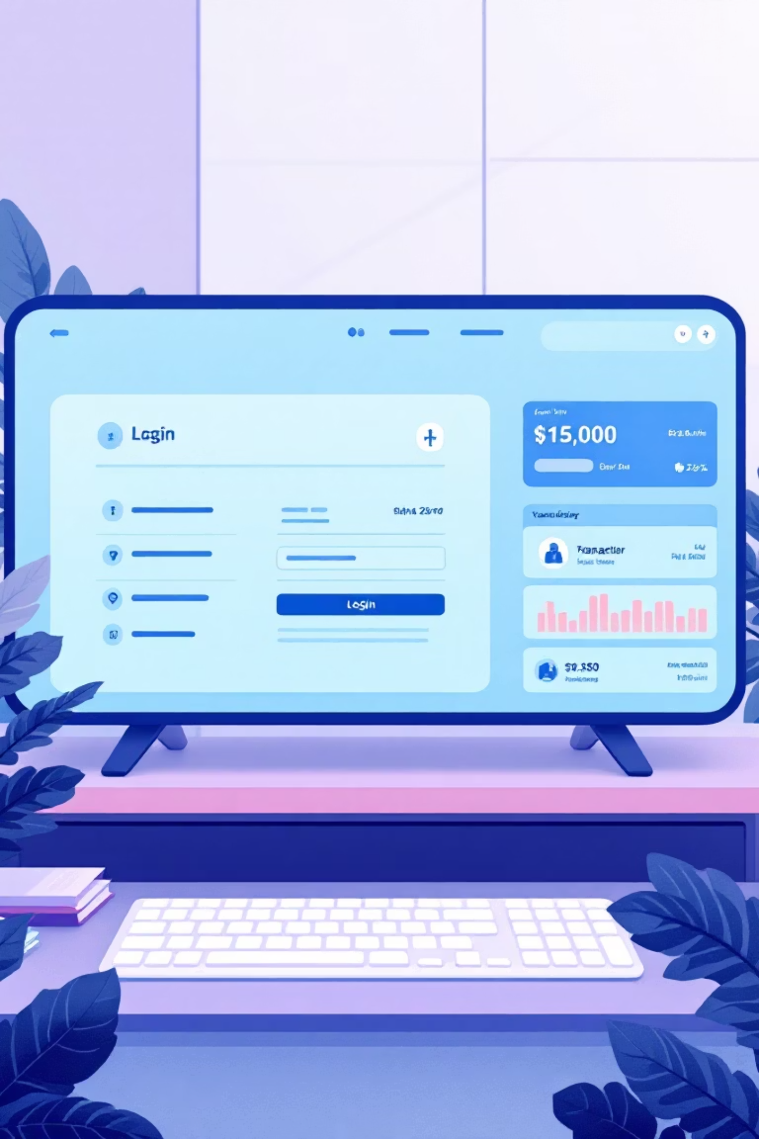

System Features
Account Management
Unique 8-digit account numbers, cryptographic password authentication, secure login/logout.
Banking Operations
Real-time deposits, withdrawals with validation, inter-account transfers, instant balance updates.
Data Persistence
Text-based file storage, timestamped transaction history, automatic serialization.
User Experience
Interactive menu, input validation, clear prompts, professional formatting.

Slide 5




System Architecture
BankingSystem
1
Main Controller
Bank
2
Account Manager
Account
3
User Operations
Transaction
4
Activity Logger
Object-Oriented Architecture with Encapsulation, Separation of Concerns, and Defensive Programming.

Slide 6
Live Demonstration
01
02
03
System Initialization
Account Creation
Authentication & Operations
Launch application, display welcome screen and main menu.
Create "John Doe" with $500, generate account number, secure password.
Login, view info, deposit +$200, withdraw -$100 (validation).
04
05
Multi-Account Operations
Data Persistence
Create "Jane Smith" ($300), transfer John → Jane ($150), show balances.
View transaction history, restart app, verify data integrity.

Slide 7

Future Enhancements
Security
Scalability
AES-256 encryption
Database integration (SQL/NoSQL)
Two-factor authentication (2FA)
RESTful API development
Session timeout
Web/Mobile frontend
Biometric authentication
Push notifications
Advanced Features
Enterprise Features
Multiple account types
Admin dashboard with analytics
Automated interest calculation
Loan management
Automated statements
Multi-currency support
Configurable transaction limits
Compliance reporting

Slide 8

Reflection & Conclusion
Implementation Success
Key Insights
Core operations, robust OOP design, comprehensive error handling, secure data persistence, intuitive UI.
Importance of defensive programming, modular design, security-first approach, and user-centric design.
Project Impact
Demonstrates production-ready coding, foundation for enterprise systems, full SDLC experience.

